Slide 1
Welcome – Matt Damschroder Ohio Beverage Association – Kimberly McConville GS1 US – Maggie Lyons, Kerri Fulton, and Gena Morgan Ohio Council of Retail Merchants – Lora Miller Discussion Working Group Members
Working Group on the Submission of a Waiver Excluding Certain Beverages from SNAP in Ohio Agenda August 21, 2025 10:00 AM – 12:00 PM

Slide 2

Overview of Ohio’s Beverage Industry
Presentation to Ohio SNAP Working Group
August 21, 2025
Kimberly McConville, Executive Director

Slide 3







Delivering for Ohio
12,083
145
$14.3 Billion
$1.2 Billion
Beverage Industry Jobs
Manufacturing Plants and Distribution Facilities
Direct Economic Impact
Wages and Benefits
$1.1 Billion
$1.8 Billion
$134 Million
Contributed in State Taxes
Contributed in Federal Taxes
Charitable Donations

Slide 4
Growing Jobs
Business & Personal Services
Agriculture
186,836
Jobs Supported by the Beverage Industry
Job numbers represent industry-employed jobs, jobs for industries that supply for the beverage industry, jobs supported by aforementioned jobs who re-spend their wages, and jobs supported by retail of our beverages.
Construction
Transportation & Communications
Government
Retail
Mining

Slide 5
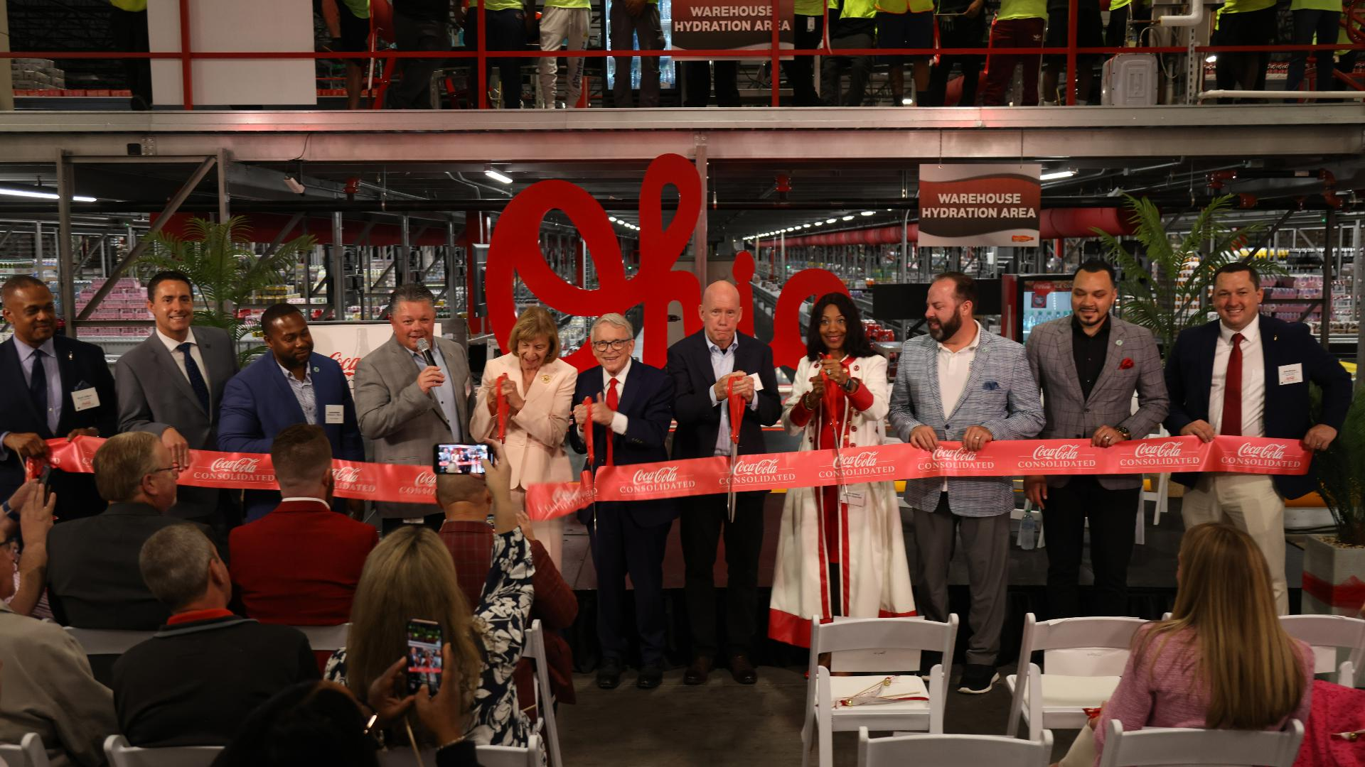
Continuing Investment
“Coca-Cola Consolidated brings jobs, high-tech expansion to Columbus”
$99 million investment
Axios, 23 May 2025
“G&J Pepsi-Cola Bottlers Expands Columbus, Operations Complex”
$30 million investment
Area Development, 26 January 2024
Coca-Cola Consolidated

Slide 6

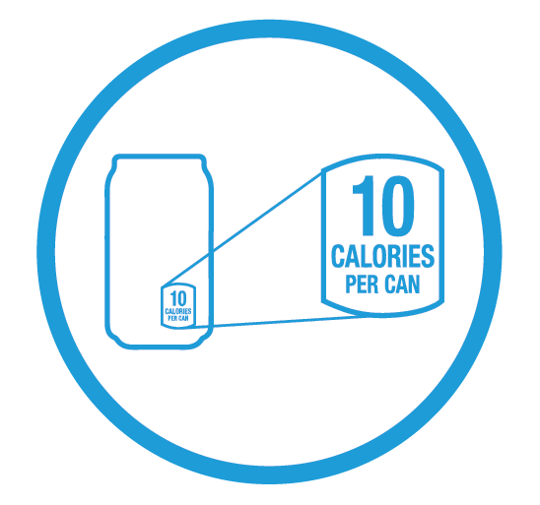


Stepping Up
The fact is no industry has done more than ours to help reduce sugar in the diet and tackle obesity.
Smaller Portions
Majority of brands now come in 7.5 oz containers for those who want a little less.
Clear Calorie Labels
Added clear calorie labels to the front of every can, bottle and pack we produce.
Transformed Schools
Voluntarily removed full-calorie beverages from schools.
Encouraging Balance
Promoting balance through displays in store and signs on coolers.

Slide 7
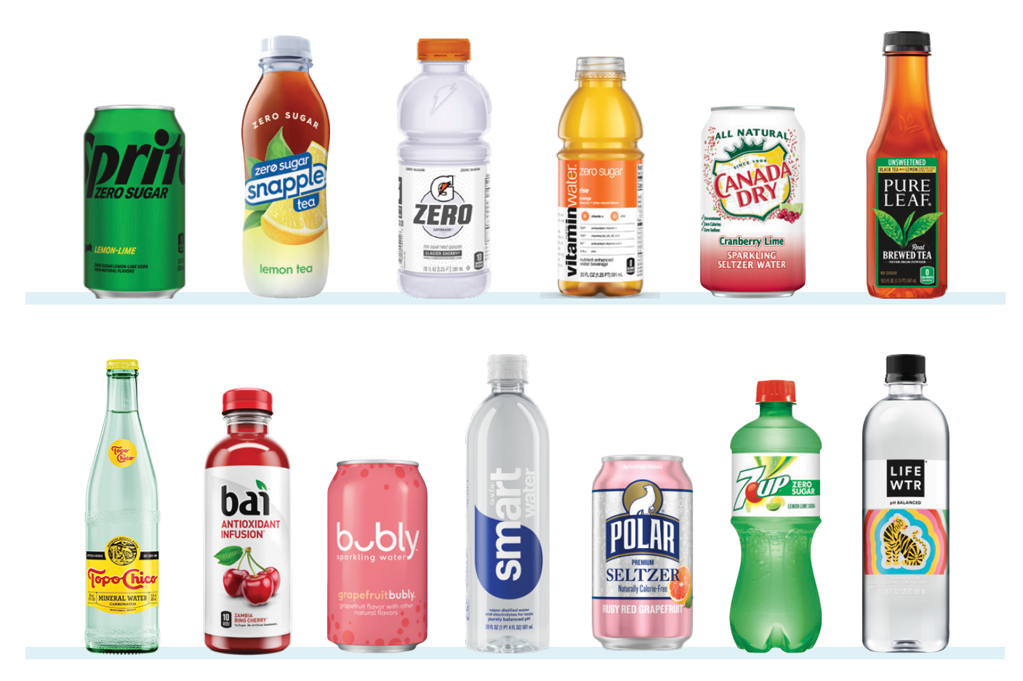
Transforming Beverage Aisle
Today, nearly 60% of beverages sold have zero sugar.
More Choices, Zero Sugar
More than 600 low or no sugar brands in the market driven by water, sparkling water, flavored water and teas.
Only Sector with Zero Calorie Options
Only food industry sector with successful zero calorie alternatives to flagship products.

Slide 8


Informing Consumers
A first stop that provides just the facts, with no opinions or recommendations – recognizing other resources are available for that.
Visit GoodToKnowFacts.org to learn more.

Slide 9
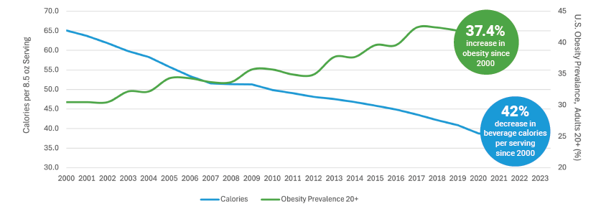
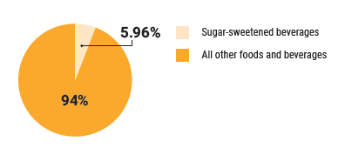
Decreasing Calories
As obesity rises, calories consumed from soda are going down.
While adult obesity is up 37.4% since 2000, full-calorie soda sales are down 22.9% and beverage calories per serving are down 42%.^{1,2} If the two were connected, obesity rates should have decreased with the decline in soda consumption.
Calories from sugar-sweetened beverages are a small part of the American diet. When consumption of all sugar-sweetened beverages are combined, they account for less than 6% of calories in the American diet, according to USDA analysis of government data.³
1 Centers for Disease Control and Prevention NCHS Data Brief: https://www.cdc.gov/nchs/products/databriefs/db360.htm
2 Beverage Marketing Corporation
3 2020 Dietary Guidelines Advisory Committee: https://www.dietaryguidelines.gov/sites/default/files/2020-07/DA_Supplement_FoodCategorySources_0.pdf

Slide 10

Final Thoughts
Thank you to Governor DeWine for convening group & chance to serve
Beverage industry touches every corner in OH
Supports hundreds of thousands of jobs
Generates nearly $3B in federal & state taxes
Expanded zero-sugar options to meet demand
Committed to working with ODJFS on timely SNAP recommendations to meet legislature’s deadline

Slide 11
Welcome – Matt Damschroder Ohio Beverage Association – Kimberly McConville GS1 US – Maggie Lyons, Kerri Fulton, and Gena Morgan Ohio Council of Retail Merchants – Lora Miller Discussion Working Group Members
Working Group on the Submission of a Waiver Excluding Certain Beverages from SNAP in Ohio Agenda August 21, 2025 10:00 AM – 12:00 PM

Slide 12
GS1 Global Product Classification (GPC)

Slide 13
Antitrust Caution
GS1 US is committed to complying fully with antitrust laws.
We ask and expect everyone to refrain from discussing prices, margins, discounts, suppliers, the timing of price changes, marketing or product plans, or other competitively sensitive topics.
If anyone has concerns about the propriety of a discussion, please inform a GS1 US® representative as soon as possible.
Please remember to make your own business decisions and that all GS1 Standards are voluntary and not mandatory.
Please review the complete GS1 US antitrust policy at: www.gs1us.org/antitrust-policy

Slide 14









14
Who is GS1 & GS1 US?
More than 10 billion GS1® barcodes are scanned every day
GS1 US® serves more than 300,000 businesses in the United States
Over 2 million companies around the world use GS1 Standards
GS1 US serves over 25 industries, including retail grocery, foodservice, healthcare, and apparel/general merchandise
The GS1 Global Data Synchronization Network™ (GDSN®) contains more than 44 million products registered by brand owners
Over 58 million products are assigned Global Trade Item Numbers (GTINs) in the GS1 US Data Hub | View/Use tool
GS1 is made up of 120 member organizations serving businesses around the world
More than 600M products are in the Global Registry Platform (GRP), and over 150k products are created and listed each week in the U.S.

Slide 15


















GS1 US Board of Governors
Leadership Committed to Standards
GS1 US Board Chairman
Vice Chairman
Vice Chairman
John W. Inwright
Former President & Chief Executive Officer Wendy’s Quality Supply Chain Co-op, Inc., Current Board Member and Strategic Advisor
Alfredo Colas
Senior Vice President of IT, Data & Analytics,
Go-To-Market, Agile & DevOps
The Procter & Gamble Company
Brian Dick
President and Chief Executive Officer
Golden State Foods
Governors
Mike Capsambelis
Director, Product Management
Bob Carpenter
President & Chief Executive Officer
Greg Cathey
Senior Vice President,
Walmart US Transformation and Innovation
Renaud de Barbuat
President & Chief Executive Officer
Dave DeLaus
Senior Vice President & CIO
Benjamin Hamilton
Vice President Supply Chain Planning
Pavan Heda, PhD
Vice President, Global Trade Controls & Enterprise Supply Chain PMO
Sam Heyworth
Vice President, Consumables
Greg Keller
Senior Vice President, National Accounts
Antonio Lee
Executive Vice President & Chief Operating Officer, PVH Americas & CK Global
Kraig Narr
Senior Vice President, Global Supply Chain & Logistics
Brad Oliver
Senior Vice President of Product Business Development
John Phillips
Senior Vice President, Customer Supply Chain & Go-To-Market
Randall J. Skoda
President & CEO
Brad Spickert
Senior Vice President, Supply Chain
Mike Stigers
President
Dick Tracy
Chief Executive Officer

Slide 16
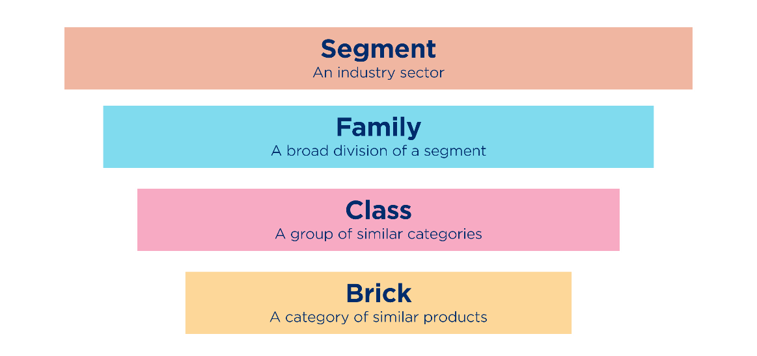
What is GS1 Global Product Classification (GPC)?
The Global Product Classification (GPC) by GS1 is a standardized taxonomy for categorizing products in the supply chain.
It arranges products hierarchically based on their characteristics and relationships, from broad categories to specific classifications. This system aids in:
Uniform product listing
Improving supply chain communication
Increasing productivity
Automation
Reducing common problems such as overstocking and returns

Slide 17
Benefits of GS1 Global Product Classification
Serves as a crucial classification system facilitating communication between parties exchanging information
Enhances buying programs by enabling buyers to identify and select relevant product groups in advance
Establishes a unified language for category management and merchandising, leading to quicker responses to consumer demands
Aids in the analysis of spending and purchasing trends within specific categories
Streamlines internal processes by organizing them into distinct categories
Acts as an essential component for the exchange of data, including integration with the Global Data Synchronization NetworkTM (GDSN®) and the GS1 Global Data Model (GDM)

Slide 18
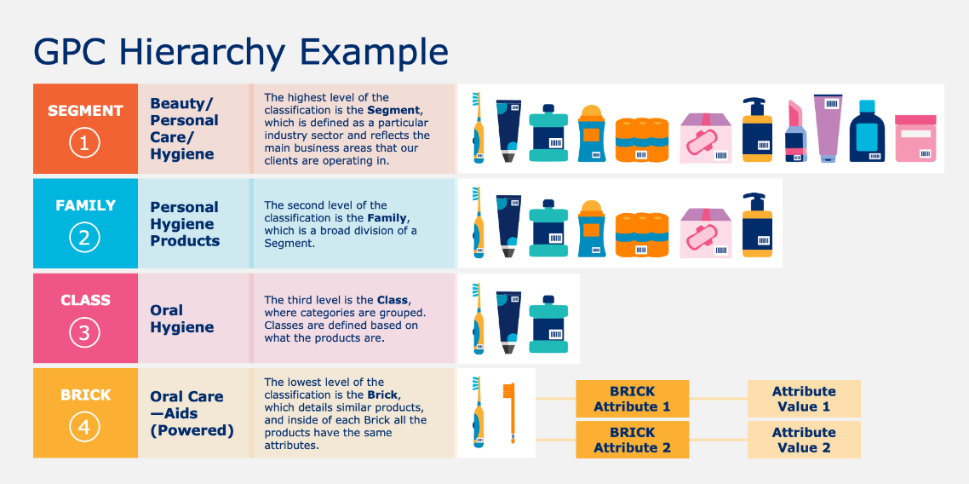
How It Works: GS1 Global Product Classification
The GPC system is a standardized framework that simplifies product categorization across different markets and industries.
It's structured into a hierarchy that starts with the broadest category, the Segment, which indicates the industry to which a product belongs.
Within each Segment, there are Families, which are groups of products that serve a common purpose.
Breaking down further, each Family contains various Classes, which are more specific groupings based on the nature of the products.
The most detailed level is the Brick, which refers to individual products that share the same features or functions.
This systematic approach ensures that products are classified consistently worldwide, enhancing communication and efficiency between suppliers and customers in the global marketplace.

Slide 19
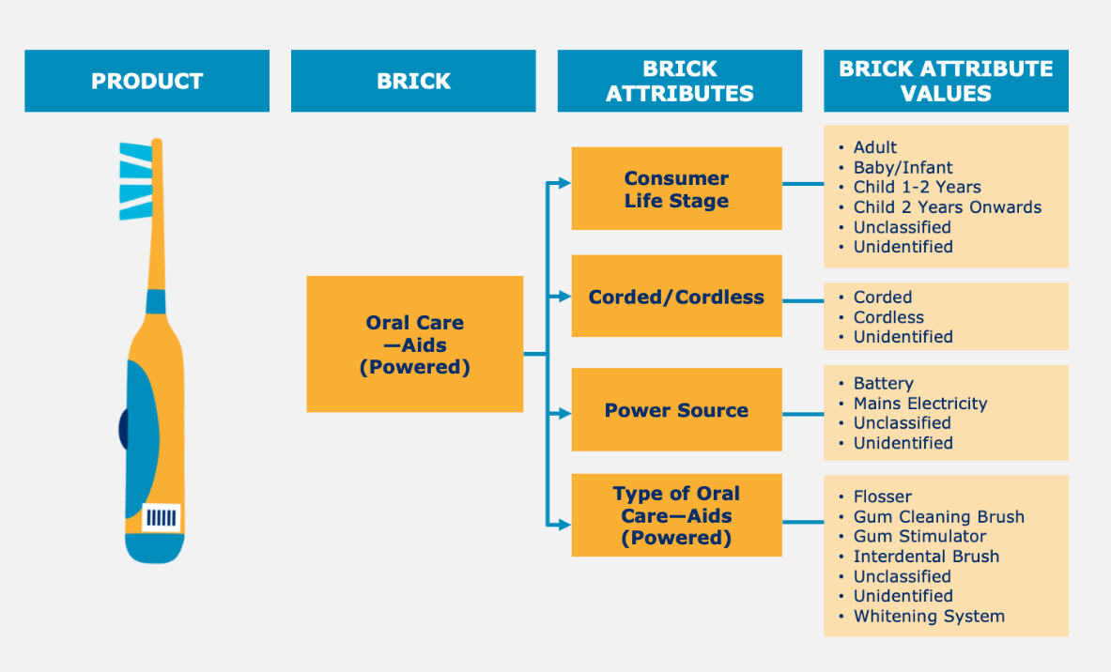
How It Works: GS1 Global Product Classification
GPC Brick Attributes and their corresponding values enhance detail by enabling queries about a Brick's features, like its power status. Conversely, Brick Attribute Values specify the choices to address these queries, for instance, selecting “Battery” or “Mains Electricity” for the power type. In essence, while the attribute sets up the query, the attribute value presents the potential solutions.

Slide 20
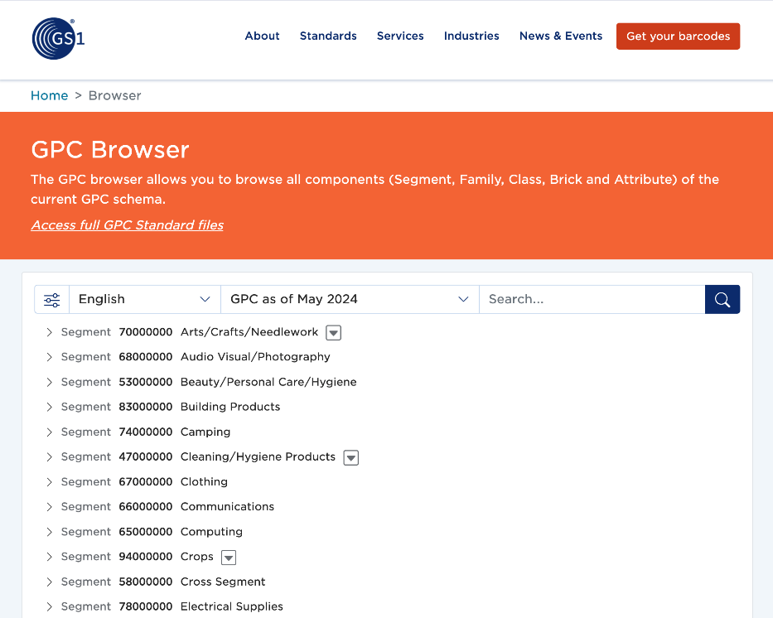
The GS1 GPC Browser: Overview
The GPC Browser streamlines your search for the essential numbers to define your product's attributes. It provides a comprehensive view of all elements within the current GPC schema, including Segment, Family, Class, Brick, and Attribute, ensuring you can easily identify the correct number without any guesswork.

Slide 21
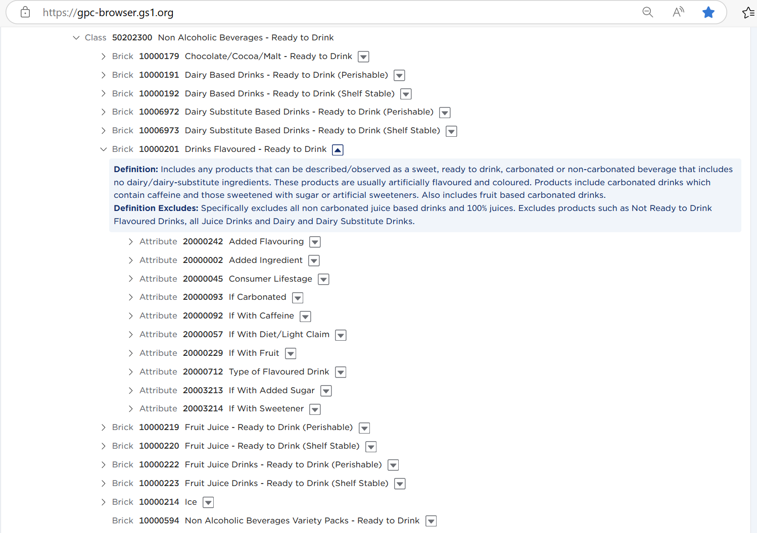
The GS1 GPC Browser: Beverages Example
Within the GPC Browser, you can explore areas of the schema relevant to your products.
Clicking on the arrow displayed on the left of each level title reveals the additional attributes related to the classification.
Clicking on the arrow box displayed on the right of each level title reveals the definition, where available.
Access more information on using the GPC Browser here.

Slide 22
Questions?
Maggie Lyons
VP, Government and Regulatory Affairs
mlyons@gs1us.org
Kerri Fulton
Director, Government Policy and Regulations
kfulton@gs1us.org

Slide 23
Legal Disclosure
GS1 US, Inc. is providing this presentation, as is, as a service to interested parties. GS1 US MAKES NO REPRESENTATIONS IN THIS REGARD AND DISCLAIMS ALL WARRANTIES, EITHER EXPRESS OR IMPLIED, INCLUDING BUT NOT LIMITED TO, ANY WARRANTY OF ACCURACY OR RELIABILITY OF ANY CONTENT, NONINFRINGEMENT, MERCHANTABILITY, OR FITNESS FOR A PARTICULAR PURPOSE.
GS1 US shall not be liable for any consequential, special, indirect, incidental, liquidated, exemplary, or punitive damages of any kind or nature whatsoever, or any lost income or profits, under any theory of liability, arising out of the use of this presentation or any content herein, even if advised of the possibility of such loss or damage or if such loss or damage could have been reasonably foreseen.

Slide 24
Trademark Notices
DataBar®, EPC®, EPCglobal®, GDSN®, GS1 Global Registry®, GTIN®, and Global Trade Item Number® are registered trademarks of GS1 AISBL.
GS1 US® and design is a registered trademark of GS1 US, Inc. Trademarks appearing in this presentation are owned by GS1 US, Inc. unless otherwise noted, and may not be used without the permission of GS1 US, Inc.
The letters “UPC” are used solely as an abbreviation for the “Universal Product Code,” which is a product identification system. They do not refer to the UPC®, which is a federally registered certification mark of the International Association of Plumbing and Mechanical Officials (”IAPMO”) to certify compliance with the Uniform Plumbing Code as authorized by IAPMO.

Slide 25
Welcome – Matt Damschroder Ohio Beverage Association – Kimberly McConville GS1 US – Maggie Lyons, Kerri Fulton, and Gena Morgan Ohio Council of Retail Merchants – Lora Miller Discussion Working Group Members
Working Group on the Submission of a Waiver Excluding Certain Beverages from SNAP in Ohio Agenda August 21, 2025 10:00 AM – 12:00 PM

Slide 26

Lora Miller
Director of Governmental Affairs
& Public Relations
August 21, 2025

Slide 27
ABOUT THE OHIO COUNCIL OF RETAIL MERCHANTS
The Ohio Council of Retail Merchants (The Council) has been serving the interests of Ohio’s retail and wholesale industries since 1922. Our 7,700-plus members rely on the expertise and passion of the Council leadership to promote and support initiatives that pave a positive path for the state’s retail community. The Council concentrates on four main areas as it relates to building and maintaining a robust retail environment – Public Policy, Political Activity, Member Benefits, and Research.
Council membership includes national, regional and local grocers.

Slide 28
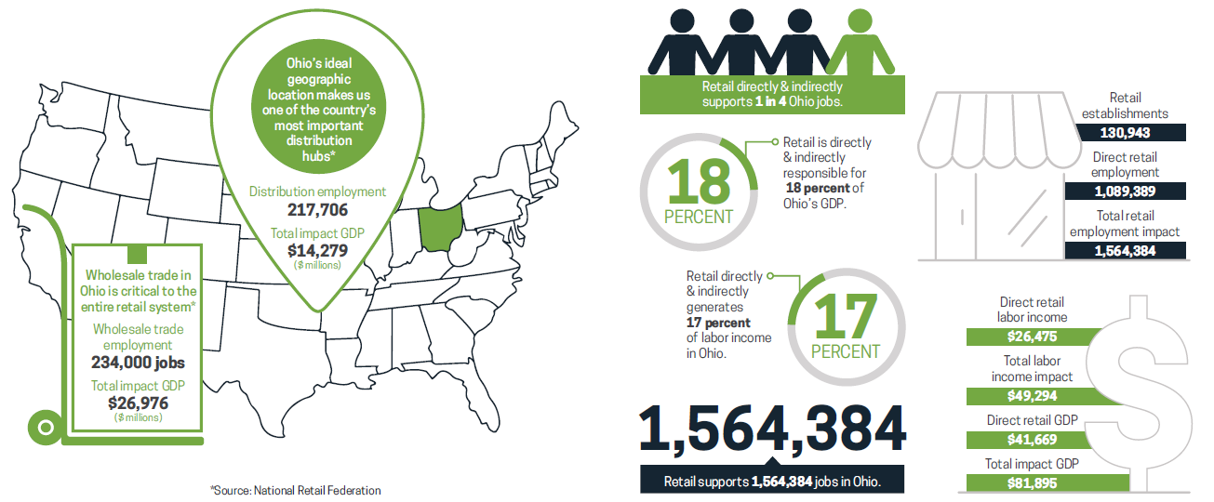
RETAIL IN OHIO

Slide 29



SNAP IS AN IMPORTANT DRIVER OF OHIO’S GROCERY INDUSTRY
SNAP generates nearly $5 billion in economic activity each year in Ohio
SNAP benefits can be used at over 9,000 Ohio grocers
SNAP is responsible for over 14,000 direct and indirect jobs in Ohio’s grocery industry
Administrative SNAP jobs at the grocery store level generated more than $323.6 million in grocery industry wages
SNAP drove total output of $910.3 million across grocery and other retailing industries in the state
Output generated by supplier and induced impacts represents another $1.1 billion

Slide 30
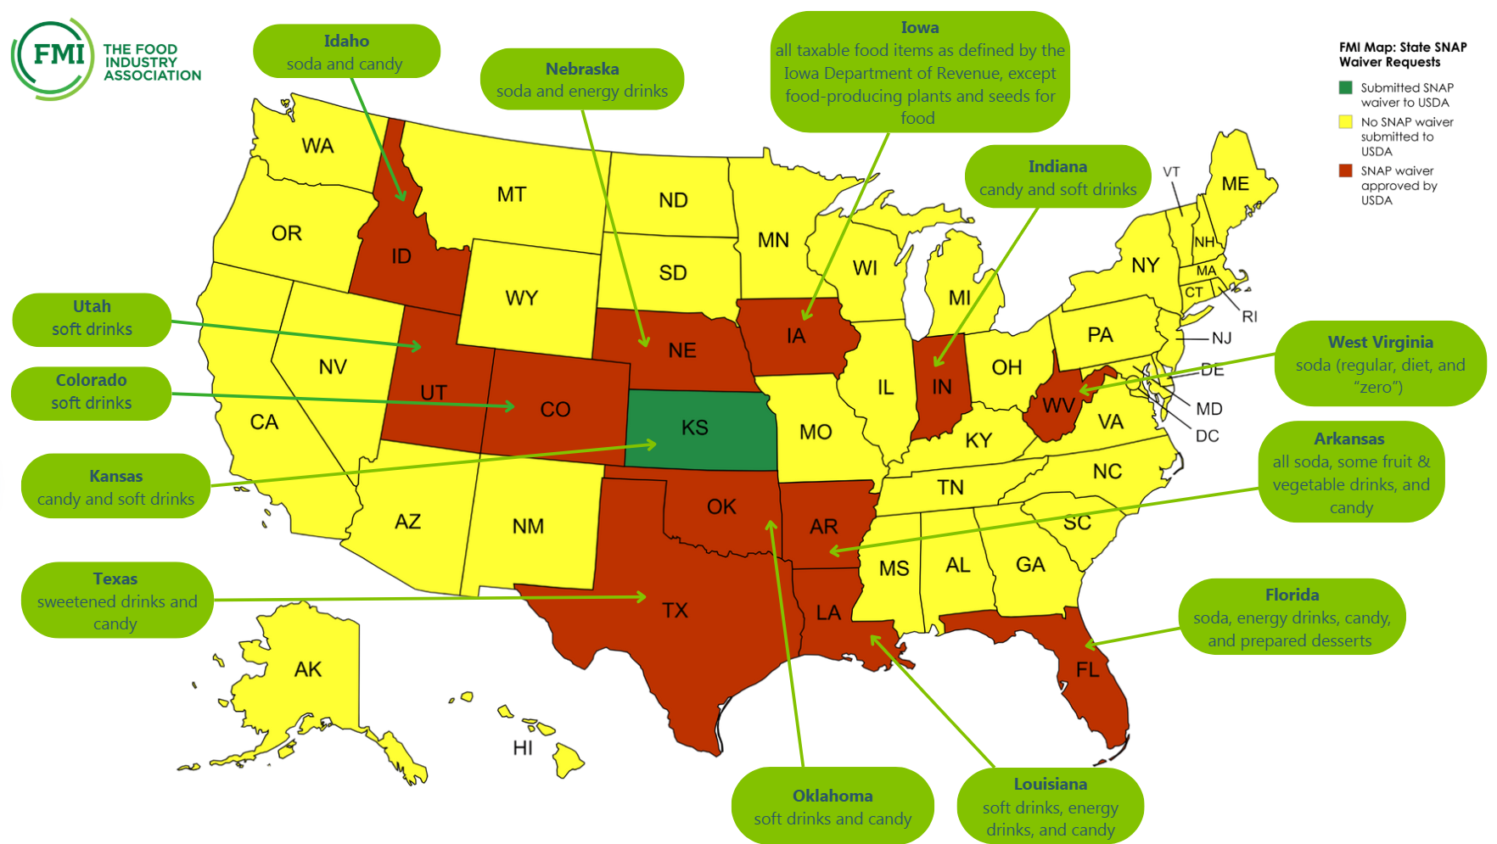
SNAP WAIVERS SUBMITTED/IN PROGRESS BY STATE

Slide 31
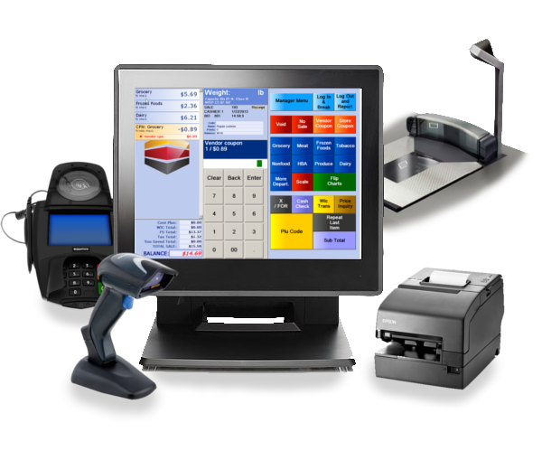
OPERATIONAL COST & BURDEN
Our grocery members, particularly those on state borders, are concerned states creating their own lists of permitted or banned items complicates the checkout process.
Grocery retailers would face costly upgrades to point-of-sale (POS) systems, regular staff retraining, and workflow disruptions as each state changes rules or introduces new products.

Slide 32

INDEPENDENT GROCERS WOULD BE MORE PROFOUNDLY IMPACTED
Smaller and independent grocers in Ohio already face pressures from inflation, labor challenges, and store closures. Added SNAP complexity could push more into closure, compounding the current food desert problem Ohio faces.

Slide 33

INCENTIVIZING HEALTHY HABITS HAS PROVEN MORE EFFECTIVE THAN RESTRICTING PRODUCTS
Evidence suggests that incentive-based approaches—like nutrition education or programs such as Produce Perks and Double Up Food Bucks—are more effective at encouraging healthy eating without creating operational burdens.

Slide 34

TIMELINE FOR ENACTING SNAP PRODUCT ELIGIBILITY IS DISRUPTIVE
The suggested January implementation date is an issue for retailers. Retailers do not introduce new information technologies during Q4 as all operational efforts are focused on the important holiday season. We would like to see a July 1, 2027 implementation date to give the state, the retailers and the recipients time to prepare.

Slide 35

FMI RECOMMENDATIONS
FMI is calling on the USDA to enact more consistent rules for SNAP across all states:
Adopt Consistent Waiver Terms in Certain Key Areas
Establish reasonable timelines for implementation and enforcement
Adopt a single set of definitions that applies to approved state food restriction Waivers
Issue Written Guidance and Resources for States, Retailers and SNAP Participants
Strengthen waiver terms relating to sales data
Clarify which state’s requirements apply to in-store and online purchases
Clarify how the approval of a state food restriction waiver impacts responsibilities for oversight, monitoring of compliance and enforcement of penalties as between USDA and the state
Develop templates and encourage standard processes across states.
Customer Education
UPC-Level List of Ineligible Products

Slide 36
IN SUMMARY
Adopt consistent product category definitions so all states comply equally
Changes to SNAP introduces burdensome operational and information technology issues that cost money
Smaller, independent retailers will be particularly impacted by SNAP changes
Incentive-based healthy eating programs have proven more effective in driving healthy eating that restricting product categories
Retailers avoid significant IT implementations during Q4 which is precisely when SNAP changes are to be implemented

Slide 37
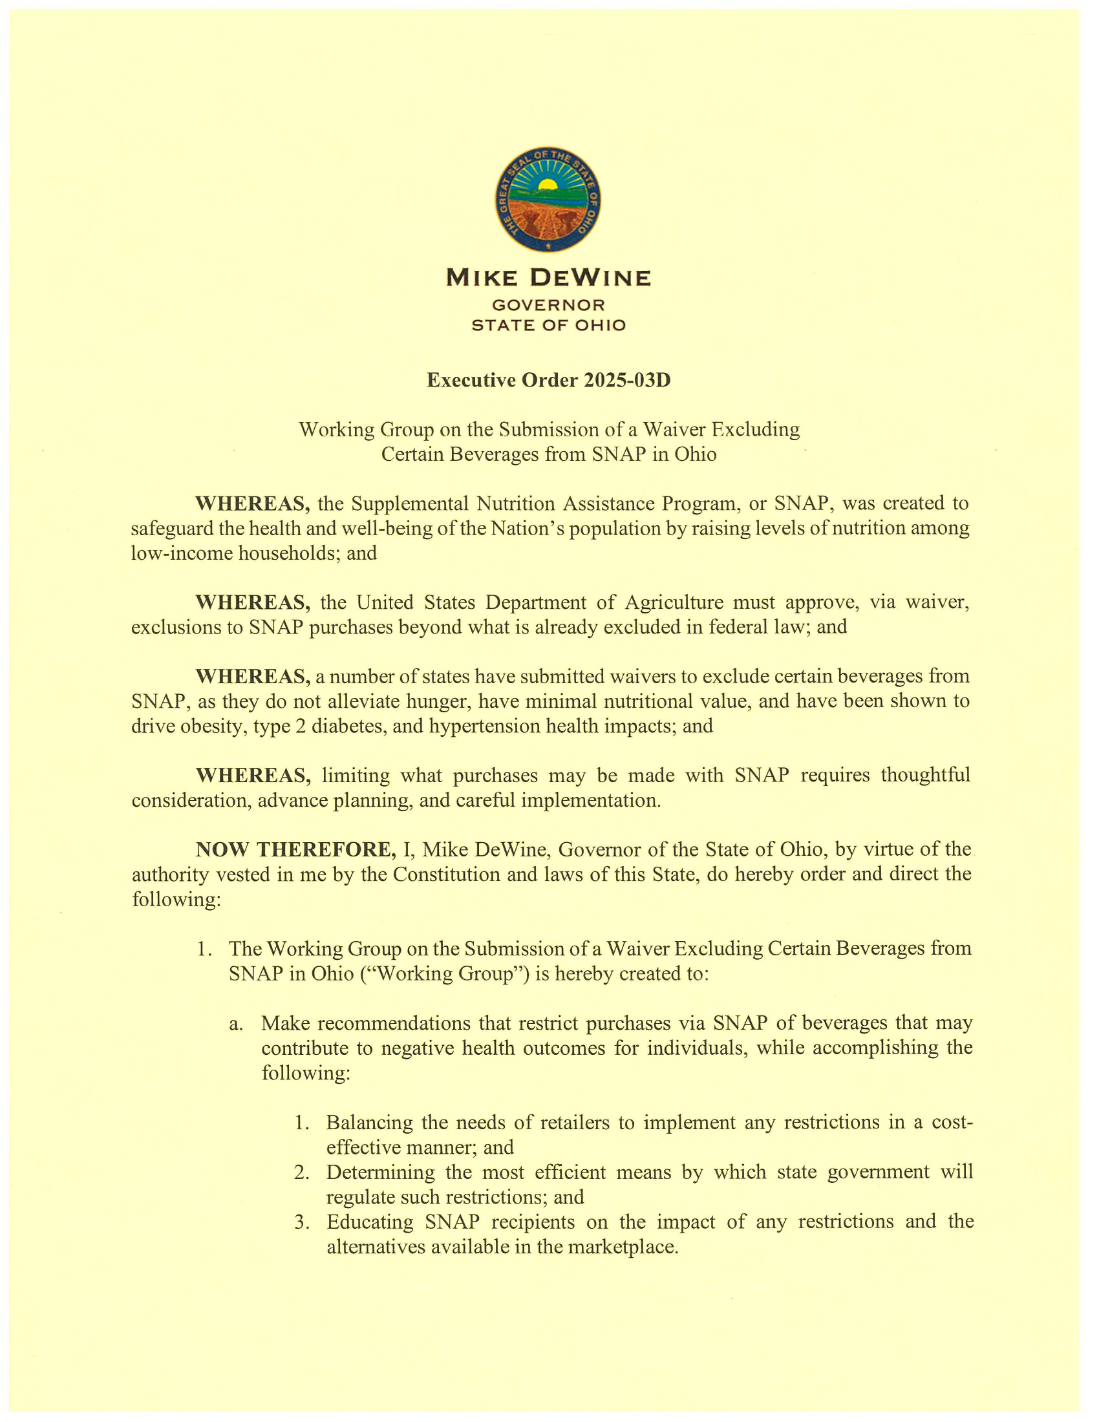
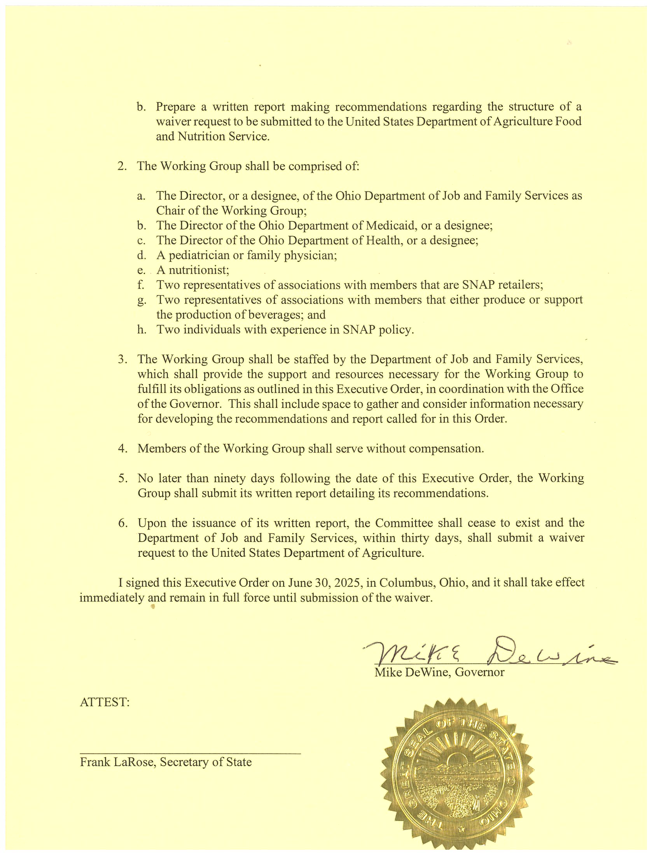
Thank you Governor DeWine, our working group and support staff for the opportunity to work together on this effort.

Slide 38
Welcome – Matt Damschroder Ohio Beverage Association – Kimberly McConville GS1 US – Maggie Lyons, Kerri Fulton, and Gena Morgan Ohio Council of Retail Merchants – Lora Miller Discussion Working Group Members
Working Group on the Submission of a Waiver Excluding Certain Beverages from SNAP in Ohio Agenda August 21, 2025 10:00 AM – 12:00 PM

